Slide 1
Medicine in the Age of Smart Machines
Fazal Khan, M.D.-J.D Associate Professor University of Georgia School of Law
Copyright

Slide 2
Smart Machines in Medicine
Transformative Potential—Achieving the “Triple Aim”
Law and Disruptive Technology
Will the Robots Take Over, and Can We Do Anything About It?
Copyright
Notes:
Law codifies social norms
Policy defines development of norms

Slide 3
The Triple Aim of Healthcare
Access—ensure universal access to necessary care
Cost—affordability for both individuals and society
Quality—delivering the right care and reducing errors
Copyright

Slide 4
Being Insured ≠ Access
Acceptance rates of patients by dermatologists
Medicare—85%
Private insurance—87%
Medicaid—32%
Mean wait times if insurance accepted
Medicare and private insurance--37 days
Medicaid--50 days
Resneck J, et al. J Am Acad Dermatol. 2004 Jan;50(1):85-92
Children—Access to specialty care
Medicaid-CHIP—64% denial rate by providers
Private Insurance (BCBS)—11% denial rate by providers
Joanna Bisgaier & Karin Rhodes, Auditing Access to Specialty Care for Children with Public Insurance, 364 NEJM 2324 (2011).
Copyright

Slide 5
Access: Primary care supply-demand mismatch
Copyright
Am Fam Physician. 2005 Nov 1;72(9):1670

Slide 6
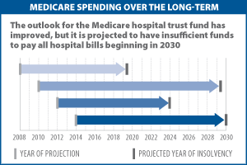
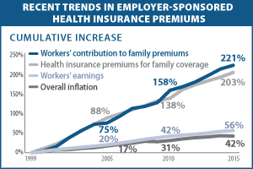
Increasing Costs
Copyright
Kaiser Family Foundation, 2016

Slide 7
Quality: Room for Improvement
Copyright

Slide 8
Train More Medical Experts?
Copyright
Notes:
Expensive. 11+ years pre-med to residency

Slide 9
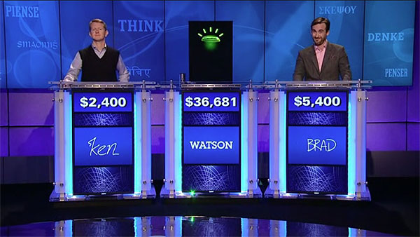
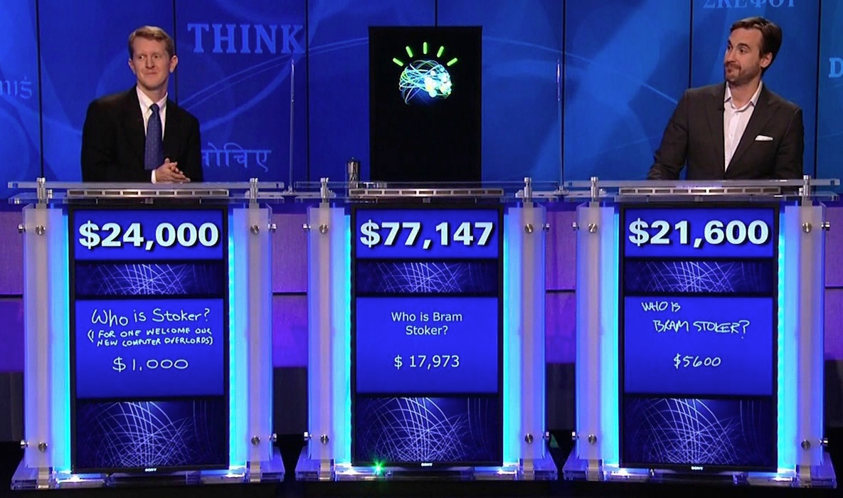
What is Pattern Recognition?
Copyright
Notes:
Wellpoint using Watson for its Clinical Decision Support Programs. Reduce diagnostic and treating errors. Reduce waste.
Read 800 million pages per second
Watson going to medical school at Cleveland Clinic. Being used by insurer Wellpoint for utilization review/recommending patient treatment to providers. .

Slide 10
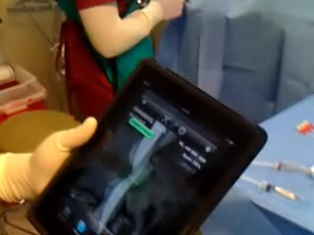
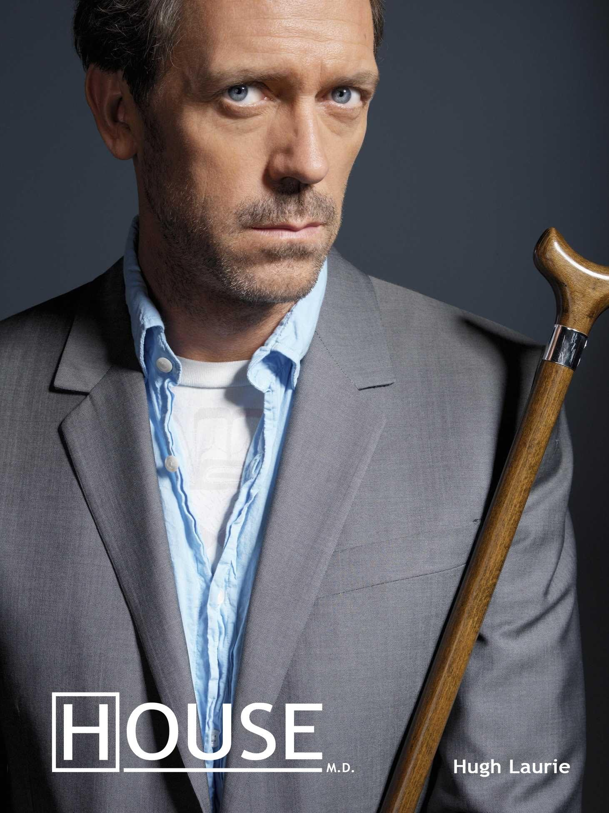
Dr. House in Your House?
Copyright
Notes:
From a previous paper. Lesser skilled and trained paraprofessionals. Train them how to use smart devices, treat wounds, deliver/dispense basic care. P
Instead of Dr. writing order to draw blood or dispense treatment—smart machine makes recommendation.
Phlebotomists, medical techs—augment their abilities. Wellpoint—RN using Watson technology for utilization review decisions.

Slide 11
mHealth: No Appointment Needed
Copyright
Skinscan App
Notes:
Cite claims made by skinscan app—as accurate as dermatologist looking under dermatatome—
Is Skinscan practicing practicing medicine?
How long for derm appt in VA or Medicaid?
Derm—pre-screen patients. See dr for treatment/advice.
Urgent care is primary care—free up ER for trauma.

Slide 12
Necessity and Technological Innovation
Copyright
Notes:
CDC—Kenya mHealth initiative:

Slide 13
Triple Aim via Smart Machines
Increase Access
Autonomize non-physicians (NPs, PAs, etc) to deliver more primary care
Patient Self-help (e.g., mHealth apps, automated kiosks)
Improve Quality
Demonstrate machine analysis equivalent or superior to highest trained professionals
Continual improvement with machine learning processing more transactional data
Eliminate human error (diagnosis and treatment)
Lower Costs
Cheaply duplicate medical expertise
Lower costs with higher mix of non-physicians and automated care
Copyright

Slide 14
The Future of Medicine?
Copyright
Economist, June 2, 2012

Slide 15
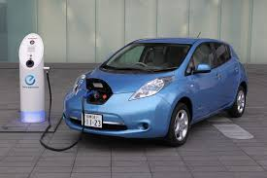
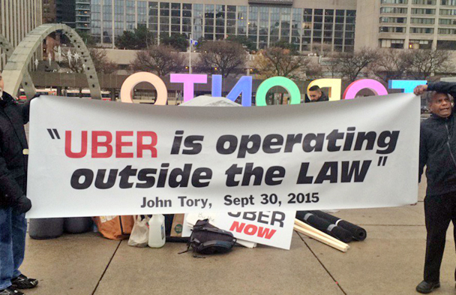
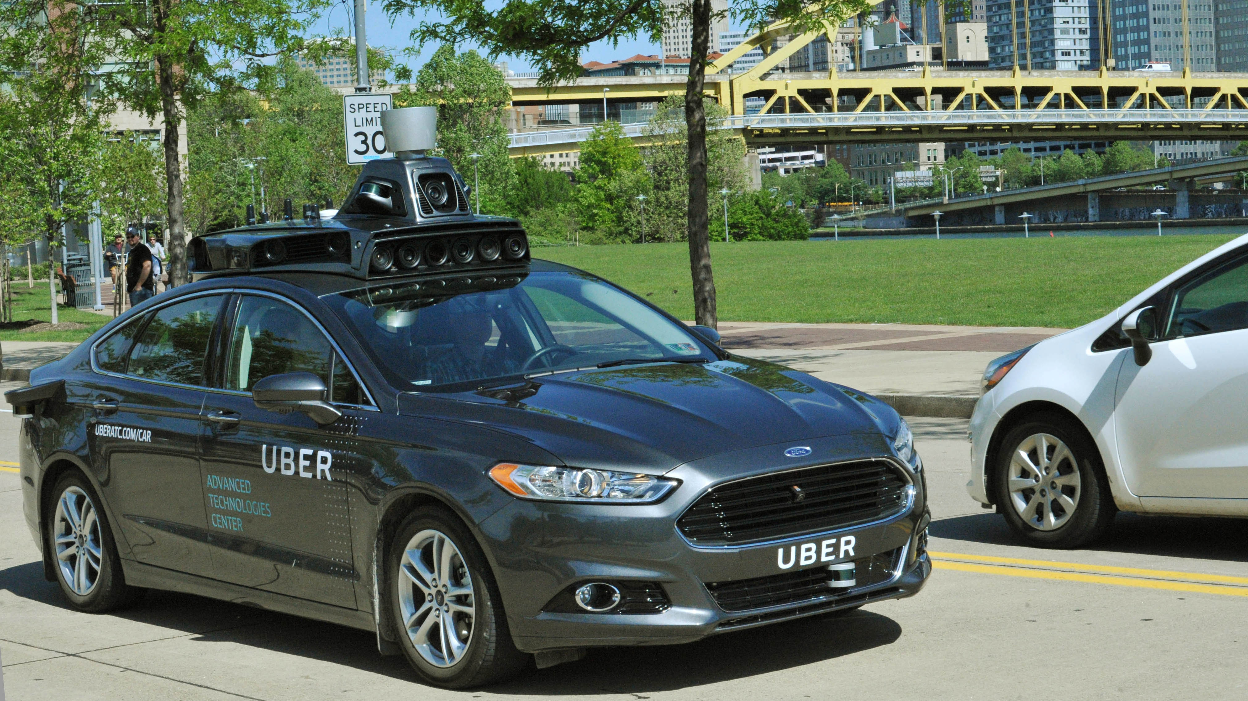
The Law and Technological Innovation
Copyright
1. Technology Forcing Regulations
2. Lack of social acceptance
3. Create social acceptance to relax regulations
4. Social Acceptance Pending
Notes:
Electric Car—technology forcing regulations—set future standards that current technology cannot meet to incentivize innovation. Kenya—all new medical device must have wi-fi capabilities.
Google Glass—after roll-out-laws and private regulations preventing use in public spaces—lack of social acceptability.
Uber—unlicensed taxi service—that did violate many municipalities licensing regulations. Example --beyond social acceptance. Social demand for service led to laws changing.
Using unlicensed taxi drivers was a bridge to Uber’s ultimate goal—driverless cars. Uber’s biggest expense? The drivers. Driverless cars also need laws and laws and laws and friendly regulatory system—they are on the way.
Google Glass--

Slide 16
Lessons from Uber vs Taxi Industry?
Undercut taxi services on cost, access, and arguably even quality
Better use of technology
Leverage existing resources more efficiently
Ignored regulatory violations until it reached critical mass or a “tipping point” of social acceptability
Politically framed service as empowering the little guy (its drivers) vs “big taxi”
Intensive lobbying and recruitment of consumer base to relax existing regulatory restrictions for its unlicensed drivers
Endgame: driverless cars
Copyright

Slide 17
Licensing and Scope of Practice Barriers
Physician groups will likely press licensing restrictions
Attempt to block non-physicians from expanding scope of practice with use of smart machines
Can the medical profession block the use of automated diagnostic and treatment technology?
Safety grounds?
Economic security?
Copyright

Slide 18
Political Economy Implications of Displacing Medical Workers
Currently the largest segment of middle class jobs in the country (U.S. Bureau of Labor Statistics)
Wide geographic distribution
Many skilled positions can be acquired at community colleges
Copyright

Slide 19
Triple Aim Without Displacement?
Develop regulatory framework for smart machines that requires keeping humans in the loop
Adapt medical training to integrate smart machines
Train physicians and non-physicians together using smart machines and adopt a team approach with physicians as managers
Prevent Silicon Valley takes all system [aka, we are not ready for Universal Basic Income system just yet[
Copyright

Slide 20
QUESTIONS?
Copyright

